Slide 1
Chapter 9
Triggers

Slide 2
Review
Review of trigger
A stored procedure is a precompiled group of SQL statements.
Database developers or administrators write stored procedures to run commonly performed administrative tasks, or to apply complex business rules. The stored procedure contains data manipulation or data retrieval statements.
Stored procedures accelerate query execution, provide faster access to data, aid modular programming, maintain consistency, and enhance security.

Slide 3
Review Contd…
There are two types of stored procedures:
  System stored procedures that offer mechanisms for database administration, and updating tables.
  User-defined stored procedures.
The CREATE PROCEDURE statement is used to create a user-defined stored procedure.
The EXECUTE statement is used to run the stored procedure.
Parameters can be used to input or output values from the stored procedure.

Slide 4
Review Contd…
There are three ways to recompile stored procedures:
  Using sp_recompile system stored procedure
  Specifying WITH RECOMPILE with CREATE PROCEDURE
  Specifying WITH RECOMPILE with EXECUTE
The ALTER PROCEDURE statement is used to modify a stored procedure.
Return codes or the RAISERROR statement are used to inform users of errors.

Slide 5
Objectives
Define triggers
List the uses of triggers
Explain the CREATE TRIGGER T-SQL statement
Describe the Inserted and Deleted tables used by triggers
Explain the types of triggers: INSERT, UPDATE, and DELETE
Identify SQL statements that cannot be used in triggers
Define nested and cascading triggers
Describe INSTEAD OF triggers
Outline the factors affecting the performance of triggers

Slide 6
Triggers
Triggers are stored procedures that are executed in response to an insert, update, or delete action against a table.
The trigger is fired automatically when one of these actions occurs.
Triggers are commonly used to enforce business rules.
Triggers guarantee data integrity and consistency.

Slide 7
Triggers Contd…
EMP Table
Ret_Emp Table
Allen
Mark
Brian
Carl
Cathy
Kathy
Greg
Retires
Derek
Derek

Slide 8
Triggers Contd…
EMP Table
Ret_Emp Table
Allen
Mark
Trigger Fired
Brian
Carl
Cathy
Kathy
Greg
Derek
Deleted
Derek
Inserted

Slide 9
Uses of Triggers
Compare versions of data
Read data from tables in other databases
Cascade changes or deletes throughout related tables in a database
Reverse invalid changes
Enforce restrictions that are more complex than those handled by CHECK constraints
Execute local and remote stored procedures

Slide 10
Creating Triggers
Triggers can be created using either the Enterprise Manager, or the Query Analyzer.
In both cases, the CREATE TRIGGER command is used to create the trigger.
Syntax:
  CREATE TRIGGER Trigger_name
  ON table
  FOR [DELETE, INSERT, UPDATE]
  [WITH ENCRYPTION]
  AS Sql_statements

Slide 11
Guidelines for Creating
Triggers
A trigger can be associated with three actions performed on a table, INSERT, UPDATE, and DELETE.
A trigger applies to a single table.
The WITH ENCRYPTION option can be used to hide a trigger definition from users. However, an encrypted trigger cannot be decrypted.
A trigger can reference a view or a temporary table, but cannot be associated with it.
A trigger can include any number of SQL statements.

Slide 12
Guidelines for Creating
Triggers Contd…
By default, only the owner of the database has permission to create a trigger. This permission is not transferable.
A trigger can be created only in the current database. However, the trigger can refer to objects of another database.

Slide 13
Using the Inserted and
Deleted Tables
Triggers access two logical tables called Inserted and Deleted.
The Inserted and Deleted tables contain images of data prior to, and after updating.
The schema is identical to the table that is being updated.
The data in the table unaffected by the update operation is not included in the Inserted and Deleted tables.

Slide 14
Types of Triggers
Insert Triggers
Update Triggers
Delete Triggers

Slide 15
INSERT Triggers
Executed whenever an attempt is made to insert data into a table.
Actions performed by the INSERT trigger:
  Insert a copy of the new row in the Inserted table.
  Examine the new row in the Inserted table, to determine whether to prevent the insert operation.
  If the values in the inserted row are valid, insert the row into the trigger table.

Slide 16
INSERT Triggers Contd…
Example:
  CREATE TRIGGER CheckRoyalty
  ON roysched
  FOR INSERT AS
  IF (SELECT royalty FROM inserted) > 30
  BEGIN
  PRINT ‘RoyaltyTrigger: Royalty cannot exceed 30’
  PRINT ‘Change the royalty to a value less than 30’
  ROLLBACK TRANSACTION
  END

Slide 17
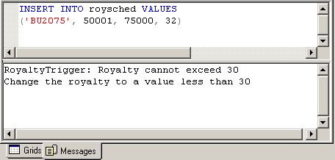
INSERT Triggers Contd…

Slide 18
UPDATE Triggers
Executed whenever an attempt is made to update data in a table.
Actions performed by the UPDATE trigger:
  Move the original row of data to the logical Deleted table.
  Insert a new row into the Inserted table, and the trigger table.
  Evaluate the values in the Deleted and Inserted tables to determine if any intervention is required.
Can be created to verify updates on a single column, or on an entire table.

Slide 19
Column-level UPDATE
Triggers
Example:
  CREATE TRIGGER NoUpdatePayterms
  ON sales
  FOR UPDATE AS
  IF UPDATE (payterms)
  BEGIN
  PRINT ‘You cannot modify the payment terms for an order’
  ROLLBACK TRANSACTION
  END

Slide 20
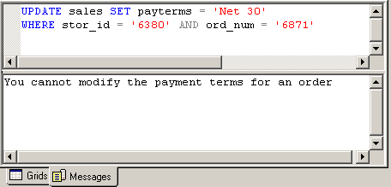
Column-level UPDATE
Triggers Contd…

Slide 21
Table-level UPDATE
Triggers
Example:
  CREATE TRIGGER NoUpdateDiscount
  ON discounts
  FOR UPDATE AS
  IF (SELECT discount FROM inserted) > 12
  BEGIN
  PRINT ‘You cannot assign a discount greater than 12 percent’
  ROLLBACK TRANSACTION
  END

Slide 22
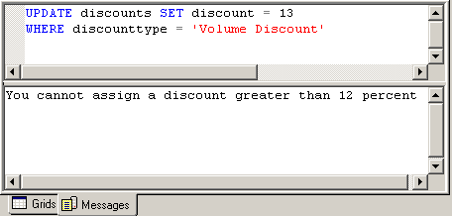
Table-level UPDATE
Triggers Contd…

Slide 23
DELETE Triggers
Executed whenever an attempt is made to delete data from a table.
Actions performed by the DELETE trigger:
  Delete the rows from the trigger table.
  Insert the deleted rows in the Deleted table.
  Examine the rows in the Deleted table to determine if, or how the trigger actions should be carried out.

Slide 24
DELETE Triggers Contd…
Example:
  CREATE TRIGGER NoDelete9901
  ON pub_info
  FOR DELETE AS
  IF (SELECT pub_id FROM deleted) = 9901
  BEGIN
  PRINT ‘You cannot delete the details of publisher 9901’
  ROLLBACK TRANSACTION
  END

Slide 25
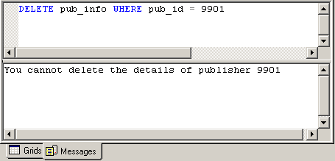
DELETE Triggers Contd…

Slide 26
SQL Statements that
cannot be used in Triggers
LOAD DATABASE
RESTORE LOG
RECONFIGURE
RESTORE DATABASE
DISK RESIZE
CREATE DATABASE
ALTER DATABASE
DISK INIT
LOAD LOG
DROP DATABASE

Slide 27
Cascading Triggers
Cascading triggers enforce referential integrity.
Cascading triggers modify data in related tables, when a change occurs in one table.
Triggers cannot be used to perform cascading updates or deletes that affect foreign and primary key constraints.
Triggers are executed after constraints are tested; if an action fails a constraint, the trigger is not executed.

Slide 28
Nested Triggers
Triggers are nested when an action in one trigger initiates another trigger, which can then initiate another trigger, and so on.
Triggers can be nested up to 32 levels.
To enable nesting use the sp_configure system stored procedure as follows:
sp_configure ‘nested trigger’, 1
To disable the nesting of triggers, execute the following statement:
sp_configure ‘nested trigger’, 0

Slide 29
INSTEAD OF Triggers
Contain code that replaces the original data manipulation statement.
Useful when data modifications are to be performed on views that are normally not update-able.
Can be based on only one data modification action.

Slide 30
INSTEAD OF Triggers
on View Contd…
Example view definition:
  CREATE VIEW Emp_pub
  AS
  SELECT emp_id, lname, job_id, pub_name
  FROM employee e, publishers p
  WHERE e.pub_id = p.pub_id

Slide 31
INSTEAD OF Triggers
on View
Example trigger definition:
  CREATE TRIGGER del_emp
  ON Emp_pub
  INSTEAD OF DELETE
  AS
  DELETE employee WHERE emp_id IN
  (SELECT emp_id FROM DELETED)

Slide 32
Triggers and Performance
Overhead associated with triggers is usually low.
Significant amount of time is spent in referencing tables other than logical tables
Deleted and inserted logical tables are always present in memory

Slide 33
Summary
Triggers are stored procedures that are automatically executed in response to an INSERT, UPDATE, or DELETE action against a table.
Triggers are commonly used to enforce business rules.
The CREATE TRIGGER statement is used to create a trigger.
Triggers have access to the Inserted and Deleted logical tables, which are local to the trigger. These tables contain images of data prior to, and after updating.

Slide 34
Summary Contd…
The types of triggers are:
  INSERT trigger: Executed whenever an attempt is made to insert data into a table. These triggers ensure that data inserted in a table is valid.
  UPDATE trigger: Executed when an update action is performed on a table. These triggers can be table-level or column-level.
  DELETE trigger: Executed when data is deleted from a table.
Cascading triggers modify data in related tables, if a change occurs in one table.

Slide 35
Summary Contd…
Triggers are nested when an action in one trigger initiates another trigger, which then initiates another trigger, and so on.
The sp_configure system stored procedure is used to enable or disable the nesting of triggers.
The INSTEAD OF trigger contains code that replaces the original data manipulation statement.
INSTEAD OF triggers are useful when data modifications are to be performed on views that are normally not updateable.
The time involved in executing a trigger is mostly spent in referencing tables other than the logical tables.

